Slide 1


CS638-APPLIED MACHINE LEARNING FINAL PROJECT
DELIVERY MOTION CLASSIFICATION
-Adnan Ali

Slide 2
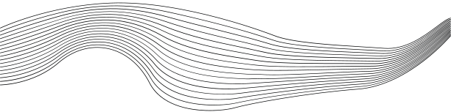
CONTENT
01
PROBLEM
02
OVERVIEW
03
DELIVERY CLASSIFICATION
04
LOGO DETECTION
05
INTEGRATION
06
FUTURE SCOPE

Slide 3
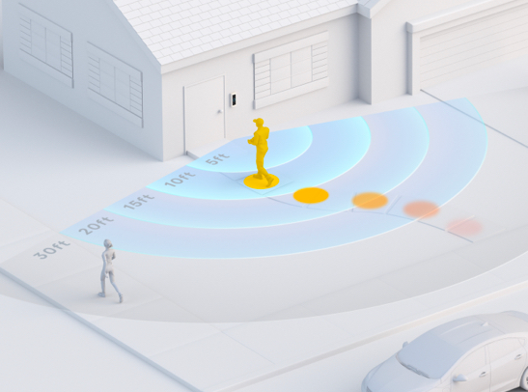



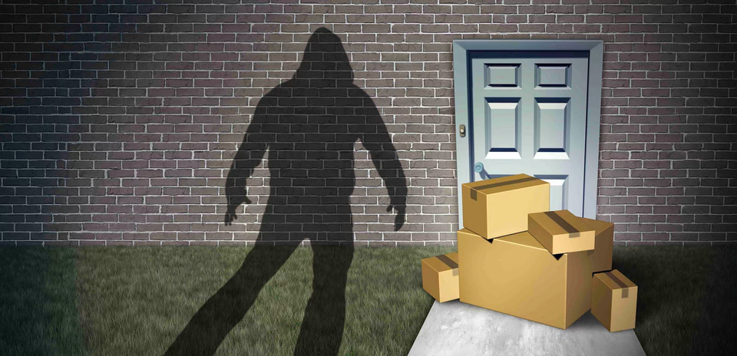
PROBLEM
Surveillance cameras like RingCentral offer motion detection and notifications.
Limitation: These cameras do not classify the type of motion detected.
High incidence of delivery parcel theft in Boston areas such as Dorchester and Roxbury.
Isn’t There a Need for More Advanced Delivery
Identification Methods in Surveillance?

Slide 4







PROJECT OVERVIEW
Logo Detection
Delivery Classification
Utilizing InceptionV3 for logo detection to accurately identify the specific delivery company, such as Amazon, USPS, Walmart, etc.
Integrate
Implementing the model to discern between delivery and non-delivery human movements.
Merging these two key functionalities into a comprehensive model to make it as Company-Specific Delivery Classification

Slide 5

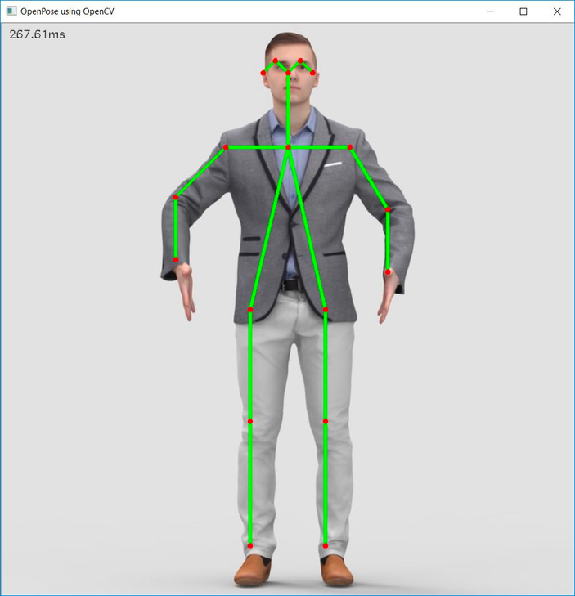
DELIVERY CLASSIFICATION
MODEL
Data Collection
Utilizing a Pre-Trained TensorFlow Pose Detection Model.
Inputting Video Frames to Extract Body Part Coordinates (Keypoints).
Representing Each Frame with Body Part Coordinates as Features.
Pre-procesing
Standardizing Coordinates Relative to HipX and HipY for Consistency Across Frames.
Analyzing Frame-to-Frame Displacement to Identify Body Part Motions.

Slide 6
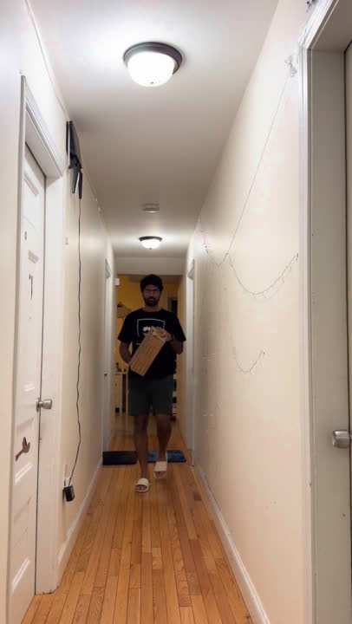
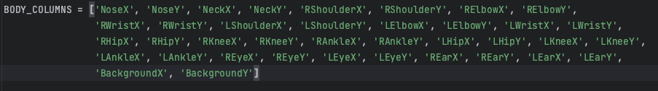
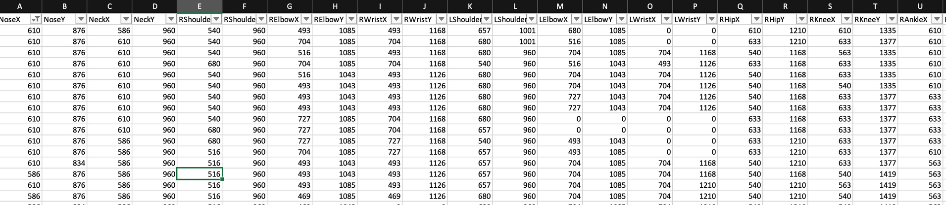
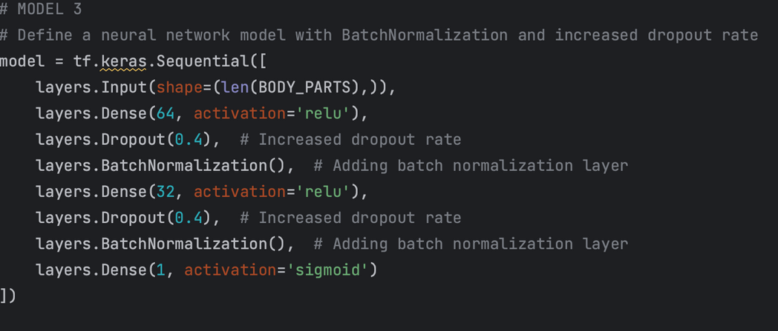
Body parts detected from OpenPose from CV
Sample Input Video
Processed data for training

Slide 7
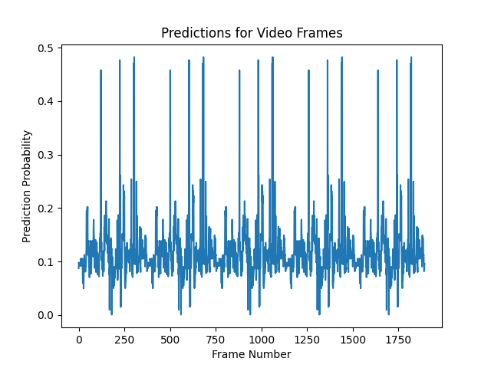
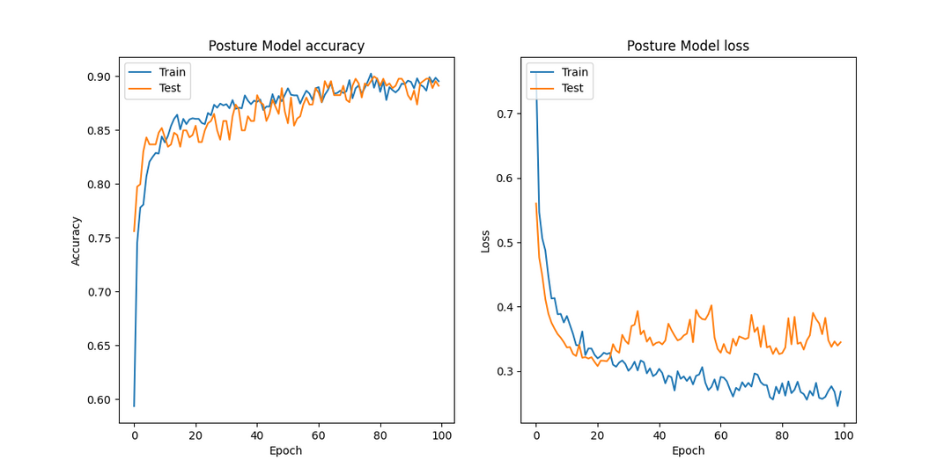
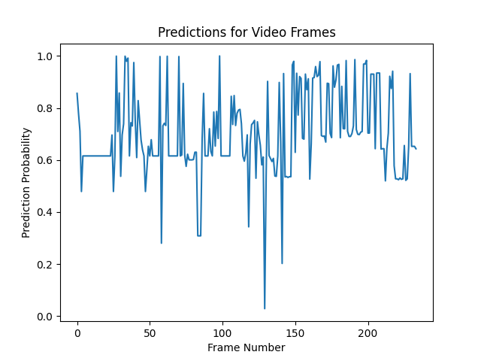
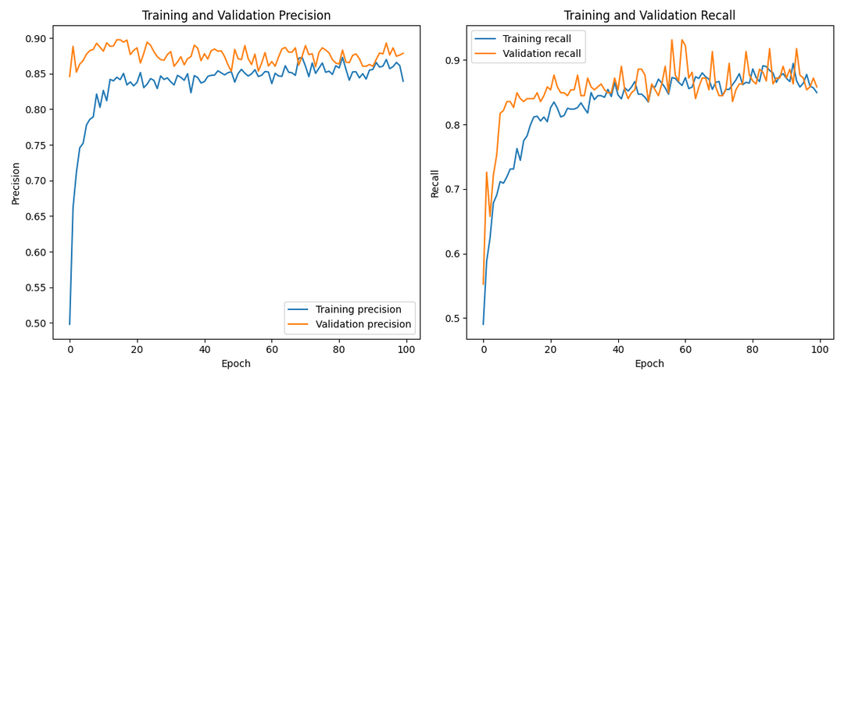
RESULTS
Non-delivery human
Accuracy and Loss
Precision and Recall
Delivery human

Slide 8
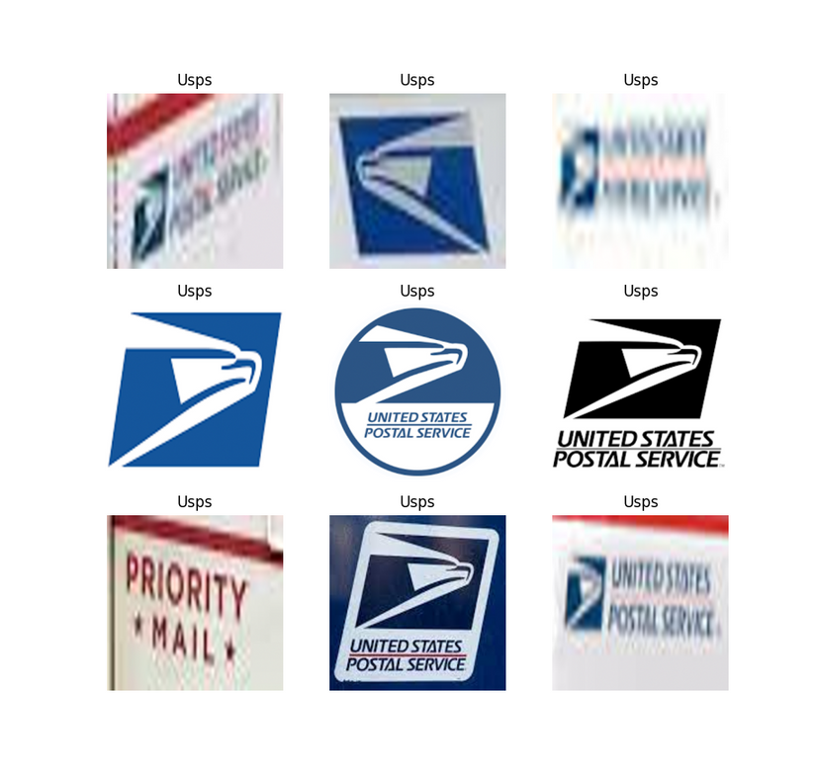
LOGO DETECTION
MODEL
Data Collection and Processing
Sourcing 150 Company-Specific Images: Amazon, Walmart, USPS, and FedEx.
Utilizing Python's LabelImg Library for Precise Logo Annotation in Images.
Feeding Annotated Images and Corresponding Labels to the InceptionV3 Model for Processing.
Optimizing Training with a Batch Size of 32 and 10 Epochs, Incorporating Data Augmentation Techniques like Flipping for Enhanced Model Performance

Slide 9
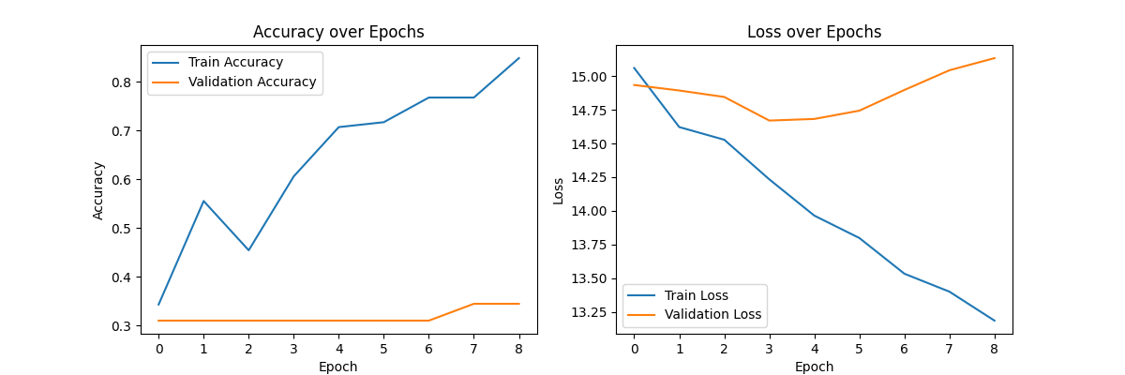

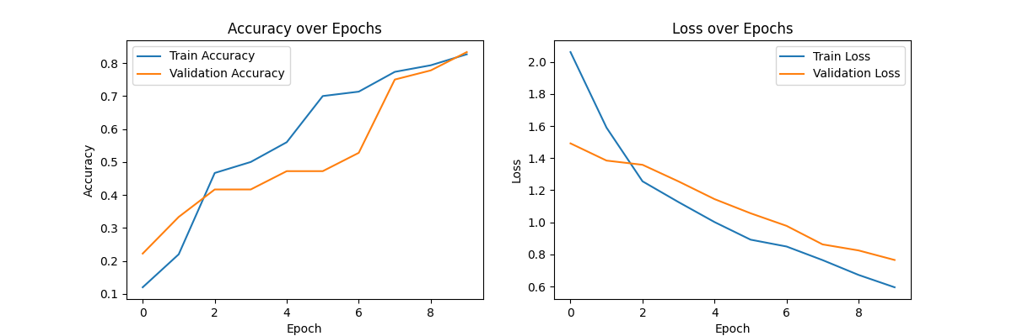
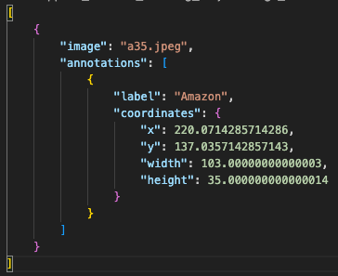
1st Model
Current Model with annotation and augmentation

Slide 10




INTEGRATION
Post 'Delivery' motion classification, the system selects one frame every 50 frames to scan for logos.
This integrated approach enables specific recognition like "Your Amazon parcel has arrived".
Each frame undergoes a thorough scan using a striding window method to pinpoint logos via the logo detection model.
STEP 1
RESULT
STEP 2

Slide 11

FUTURE SCOPE
01
02
03
04
EXPANDING DETECTION
SCOPE
DIRECTIONAL MOTION ACTIVATION
COMPREHENSIVE MOTION ANALYSIS
DIVERSE MOTION DETECTION
Current focus is on single-human frames. Future iterations aim to identify multiple individuals per frame.
Refining the model to activate only when a person approaches the camera, reducing false triggers.
Differentiating between a delivery person and potential thief by analyzing both approaching and departing motions.
Incorporating capabilities to identify distinct motion patterns, such as armed individuals.

Slide 12


ANY QUESTIONS?

Slide 13

THANK YOU...

